Slide 1
The Passion
The Vision
The Team
What Makes Our Company Tick?

Slide 2
About
We’re a global information management company serving large and aspiring enterprise
We lever value from WikiSuite Open Source information management software by creating ready-to-play solutions for our clients around the world.
We educate and promote on the use of the WikiSuite open source digital platform, and we offer turnkey solutions to meet YOUR information management needs.
We make digital transformation happen one customer at a time.

Slide 3
The Passion
A business is its people. In our case, our team shares a passion in the potential of open source technology to supercharge digital innovation, drive creativity, fairly build and distribute wealth; ultimately making for a better world.
Many of our best contributors are bright sparks, hard working dads, part-time carers, dedicated mums, college nerds… the sort of people that you’ll find at their best when they’re solving problems, building things, making the world tick-tock a little faster.
And then, time and again, they come together to build something special.
It could be YOUR something special.

Slide 4
The Vision
Our vision is a FREE open source information management ecosystem that creative people around the world can use to create wealth for their families by applying it to bring enterprises a competitive advantage by operating digital platforms that fit 100% of their business needs, not 90%, or 70%... or 60%...
Why? Creating a ‘single-version-of-the-truth’ digital environment is predicated on IT systems and apps talking together. That doesn’t happen with commercial software:
It’s too expensive to fine-tune or tailor
SaaS apps are rarely ‘good sharers’
Most vendors operate pile-it-high business models that depend on large maintenance and upgrade costs
Almost always commercial apps leave a messy legacy burden for IT teams

Slide 5
The Team
We employ over 50 people across four continents
Our workforce is primarily comprised of software programmers, analysts, consultants and project managers. Many have worked with us for several years.
Each of our team has been selected based on their experience and track-record of project success. As the leading provider of open source information management, we are part of a global community in excess of 20,000 individuals, invested in the subject of open source software development.
We get to pick the brightest minds and the most gifted talents to add to our team.
We use our own software to run our business
Every aspect of our business – from the software that runs our website and powers our conference calls, to the back-office CRM and finance software that drives our business, all originates from the code we install into our clients. We are our own best reference site.
What characterises our people?
Self-starters, highly intelligent problem solvers, forensically analytical and with exceptional attention to detail, people who get the job done – with a commitment to delivering exceptional customer value underpinned by a deep appreciation of open source.
Notes:
Free software is distributed with licences, generally without any guarantees. To obtain the right to use the software, the holder of the rights must authorise this. In the case of open source software, various free licences summarise the freedoms and rules. They are divided into 3 main licence types:

Slide 6
Find out more about our values

Slide 7
Sustainability

Slide 8

We care about the planet
If any reason were needed, we encourage all of our people to take environmental sustainability seriously.
Fortunately, in our business, we do very few things that might contribute to a carbon footprint, or produce unwarranted package waste or emissions. The biggest impacts relate to travel and transport choices.
Nevertheless, we believe it is incumbent on each one of us to do what we can to consider our actions and choices to minimise the impact on the sustainability of our planet.
For more details, please ask for a copy of our Corporate Social Responsibility (CSR) agenda. It explains in detail what we do to keep the planet safe, and how well we’re doing.
We all live on the same planet
One planet
There is no 'planet b'
www.evoludata.com

Slide 9
10 things we do to minimize our sustainability impact as a company.
Appointed an Environmental Officer
Encourage home working to remove or minimize commuter impacts
Leverage virtual conferencing as a means to reduce airmiles
Recommend our people to refrain from using unrecyclable coffee cups
Source energy from 100% recyclable sources for our premises whenever we can
Engage in carbon neutral programs
Discourage use of hard copy; and using laser printing devices that create more emissions, consume more energy, produce more package waste, and result in higher frequency replacement cycles
Regularly attend environmental and ISO 14001 events to benchmark our processes
Perform annual reviews of our environmental impact
Encourage our people to make sustainable choices
Behaviours we encourage in our workforce, suppliers and partners
Always consider whether your journey is necessary
If it is, consider the sustainability impact of your travel choice
When commuting, find out if you can car-share
Use the social office and virtual conferencing tools we provide to conduct meetings online when you can
Explore if your home or office energy provider is sourcing energy from 100% recyclable sources, and – if not - see if you can switch
Consider the recyclability of packaging materials for parcels you request or ship
Don’t print or mail documents unless you have too
And sign up to the WWF Carbon footprint calculator to discover your carbon footprint at: https://footprint.wwf.org.uk/#/

Slide 10
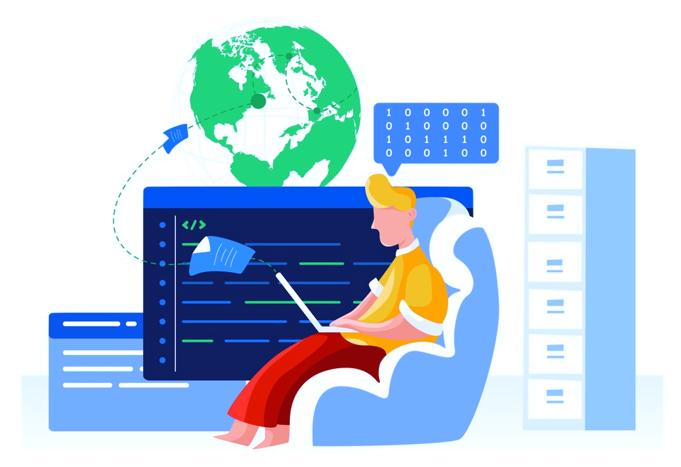
Data Privacy

Slide 11
We believe that digital data privacy is a human right
Irrespective of whatever legal safeguards may exist, we believe that it is a fundamental human right for an individual to have governance over their personal data and how it is used.
In a data driven world, it's more difficult than ever to protect the use of personal data.
We take every precaution to keep data safe, practicing Privacy by Design, by which we mean the foundation of every system, process and decision is framed by our ability to honour the rights of citizens to have their data rights protected.
Safeguards we adopt to maintain citizen data privacy rights include:
Having an appointed Data Protection Officer
Embrace the Privacy by Design principle that underpins the General Data Protection Regulation
Always ensuring we have appropriate permissions to process and store data
Making sensible choices in the type of personal data we process and store
Operating documented and formalised processes that include clear instructions over the handling, storage and destruction of personal data
Locating data servers within the territory of the data subject
Maintaining a single version of the truth data model that de-risks IS
Performing regular assessments of the efficacy of our data privacy and protection policies, and their enforcement
Operating an effective workforce induction and lifelong learning approach that ensures our people appreciate their responsibilities when it comes to processing and personal data
11
www.evoludata.com
Notes:
In the 20th Century, publishers enjoyed certain monopolies. The models of these proprietary providers offered solutions “culturally embedded” within the company. Their choice of solutions was therefore simply justified internally. Their marketing power is high, and they do not hesitate to carry out lobbying with decision-makers. Major publishers constitute guarantee brands, an insurance policy, a guarantee of security for the Executive Committee and the CEO. In addition, they propose a single manager who takes care of everything, such as, development, support and maintenance. This model reduces the individual's risk-taking ... at the risk of increasing it for the company. Keeping risks to an acceptable level is vital for the company. Risk management in general serves several purposes:
• Create and maintain the value, the assets and the reputation of a company;
• Secure the company's decision-making and processes to encourage the achievement of objectives;
• Promote the coherence of actions using the corporate values;
• Mobilise the company's employees around a common vision of the main risks.

Slide 12
Data Security
www.evoludata.com

Slide 13
In a connected world, it has become simpler for criminals to access, intercept or acquire data. Data is always at risk - in transit, or when at rest.
EvoluData is a technology services company with global clients and a distributed workforce. Our business relies on data, lives on it.
We hold data on our employees, process data on behalf of our clients and potentially have access to confidential and sensitive data our clients hold on their customers.
In such a data-rich, federated ecosystem, we recognize the threats that exist to misplace or lose data. For this reason, we operate a robust data security policy.
Safeguards we adopt to keep data safe include:
Having an appointed Data Security Officer
Operate our business activities in accordance to ISO 27002 best practise principles
Installed security policies that prohibit members of staff from using unencrypted hard drives or personal email addresses, or removing data from customer or company sites without consent
Always ensuring Users have appropriate permissions to process and store data
Maintaining an employee handbook; and operating an effective workforce induction and lifelong learning approach that ensures our people appreciate their responsibilities when it comes to data security
Installing physical security measures to reduce risk of compromise to perimeter security defences that might cause people to assume unauthorised Users are permitted to operate in the workspace
Adopting suitable data backup procedures
Adopting virtual security measures to prohibit unauthorised access to trusted networks
Leveraging technology tools to secure data in transit and while at rest
Providing awareness training and simple mechanisms for Users to report suspicious phishing emails
Operating documented and formalised processes that include clear instructions on the handling of data and protocols surrounding how to handle client information
Maintaining a single version of the truth data model that de-risks replication of data, and holding data locally on hard driver
Performing regular assessments of the efficacy of our data security policies, and their enforcement

Slide 14
Fairness & Diversity
www.evoludata.com

Slide 15
Every month of the year, EvoluData brings wealth creation to people operating across five continents
Things we do to protect the fairness culture of our business and larger work community include:
Ensuring executive hiring and operational decisions are not influenced by gender bias language.
Making clear to our workforce through our company handbook that we adopt a zero-tolerance approach to discrimination of any form.
Reminding our workforce and customers of the importance of fair-play and even-handed decision making through our internal communications and training.
Encouraging our workforce to take our effective communications course that highlights the importance of appreciating cultural differences to avoid upset or misunderstandings.
Our whistle-blower hotline email address to report perceived bias or behaviours deemed to be inappropriate - which we are committed to taking extremely seriously.
We’re passionate about the opportunity technology innovation offers to sponsor entrepreneurialism and distributed wealth creation.
Fundamental to our principles is a belief in the spirit of fair play founded on meritocratic values; promoting individualism and a sense of community oriented around wealth creation.
Open source technology thrives on the goodwill of individuals working together for the common good.
There’ s no place in our ecosystem for bigotry, racism, sexual discrimination or any other behaviours that distort a community driven by self worth and endeavour.

Slide 16
How we work

Slide 17
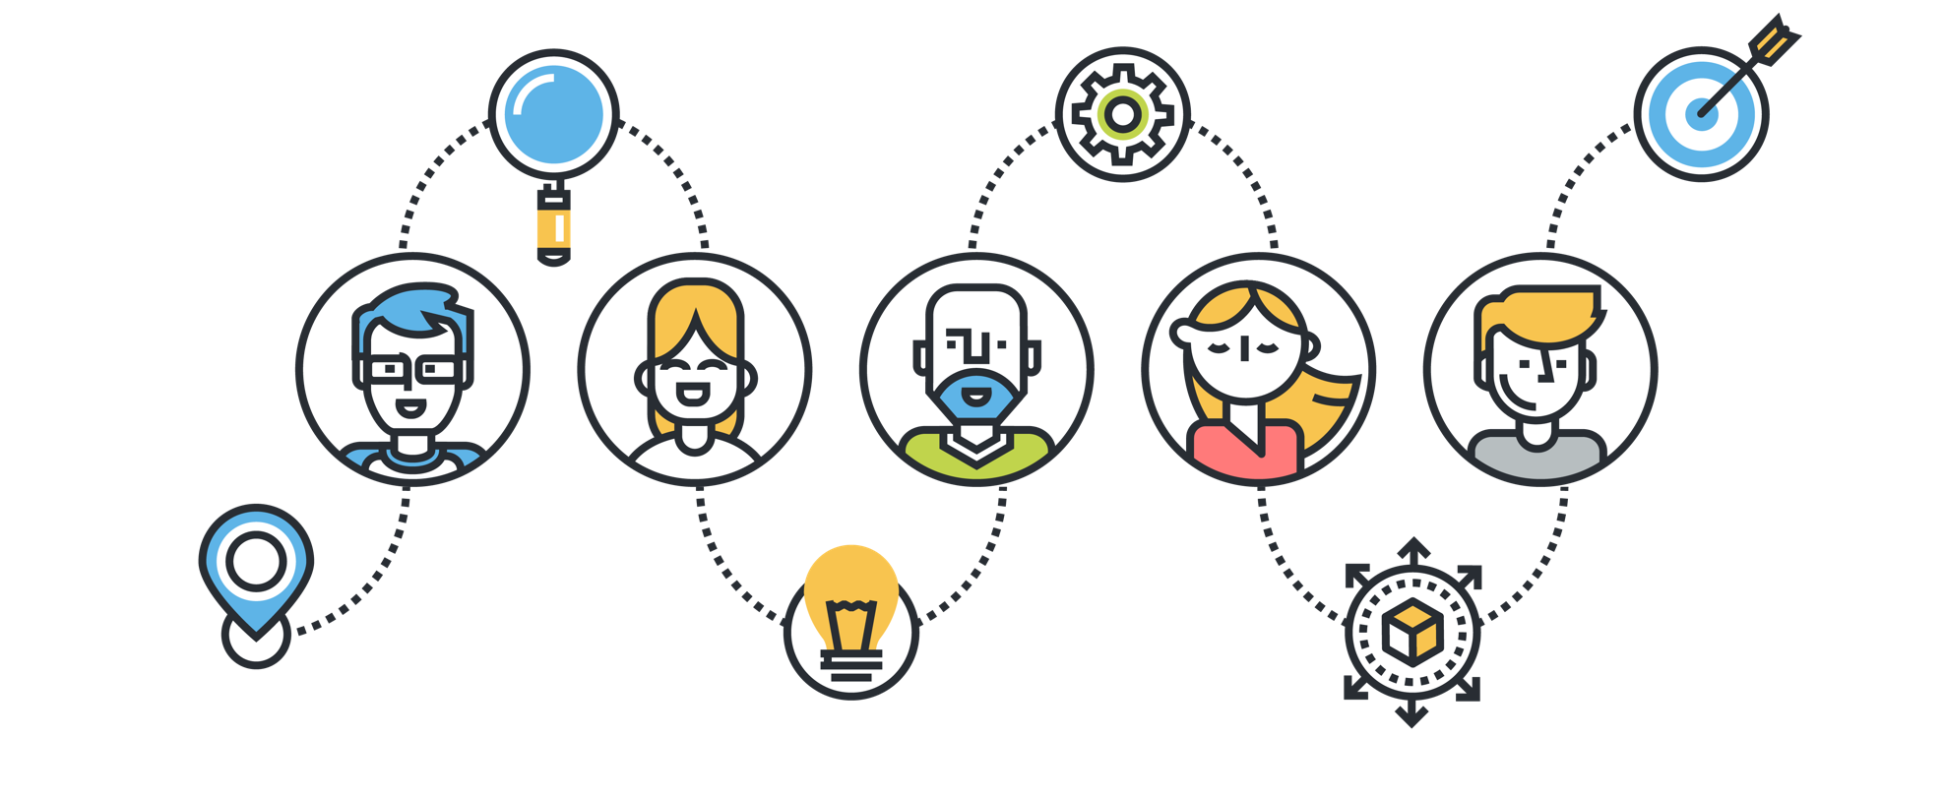
We Sell Outcomes Not Software
Invest in a solution from EvoluData, you’re not buying a piece of software. What you buy are clear outcomes tied to a Statement of Work (SOW) and a fully costed proposal that includes:
Design of your solution
Configuration to your best-fit needs
A technical support agreement
Clearly costed optional enhancements and access to our expert resources on a time and materials basis

Slide 18

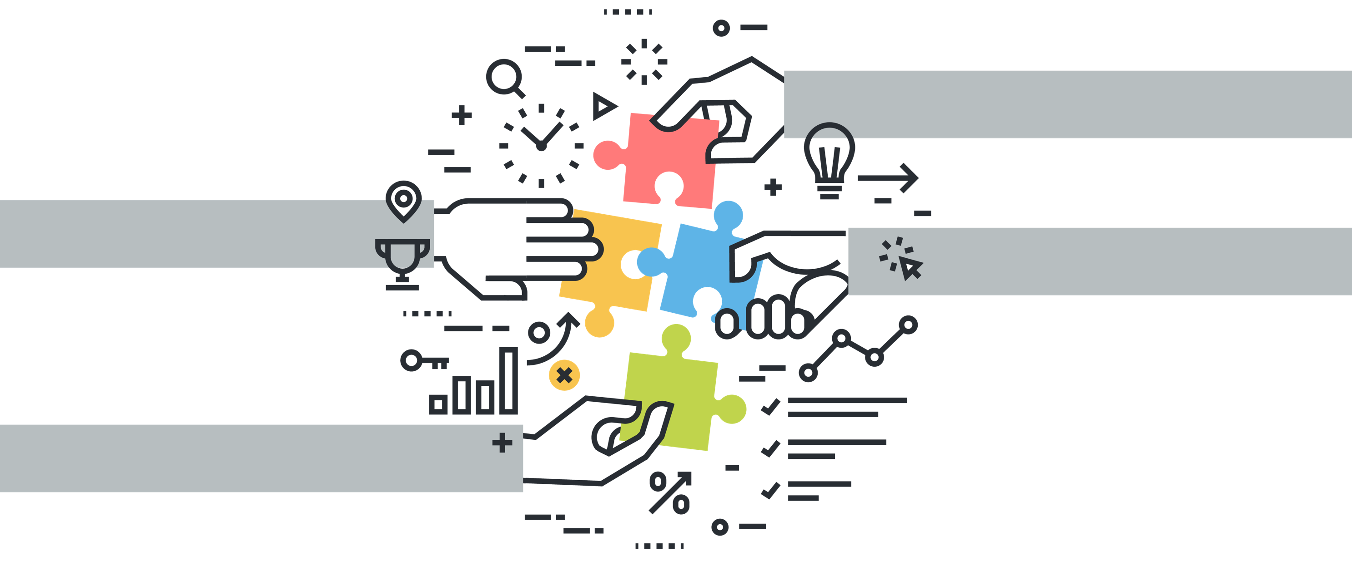
The Software is Always FREE
The great thing about Open Source from EvoluData is the software we configure for you is supplied COMPLETELY free. No strings.
We calculate there are in excess of 500,000 development hours built into our software. That works out to USD $5 million of value.
There are also many other suppliers that can do the work we do, so you’re not commercially tied in any way.

Slide 19

Transparent Proposals
We’ve pioneered an approach to writing proposals that ensures you know precisely what to expect and what you’re paying.
That’s because we believe transparency and clarity in contract negotiations is fundamentally better for both parties.
Request a proposal and experience the refreshing difference in our FREEDOM agreements.

Slide 20
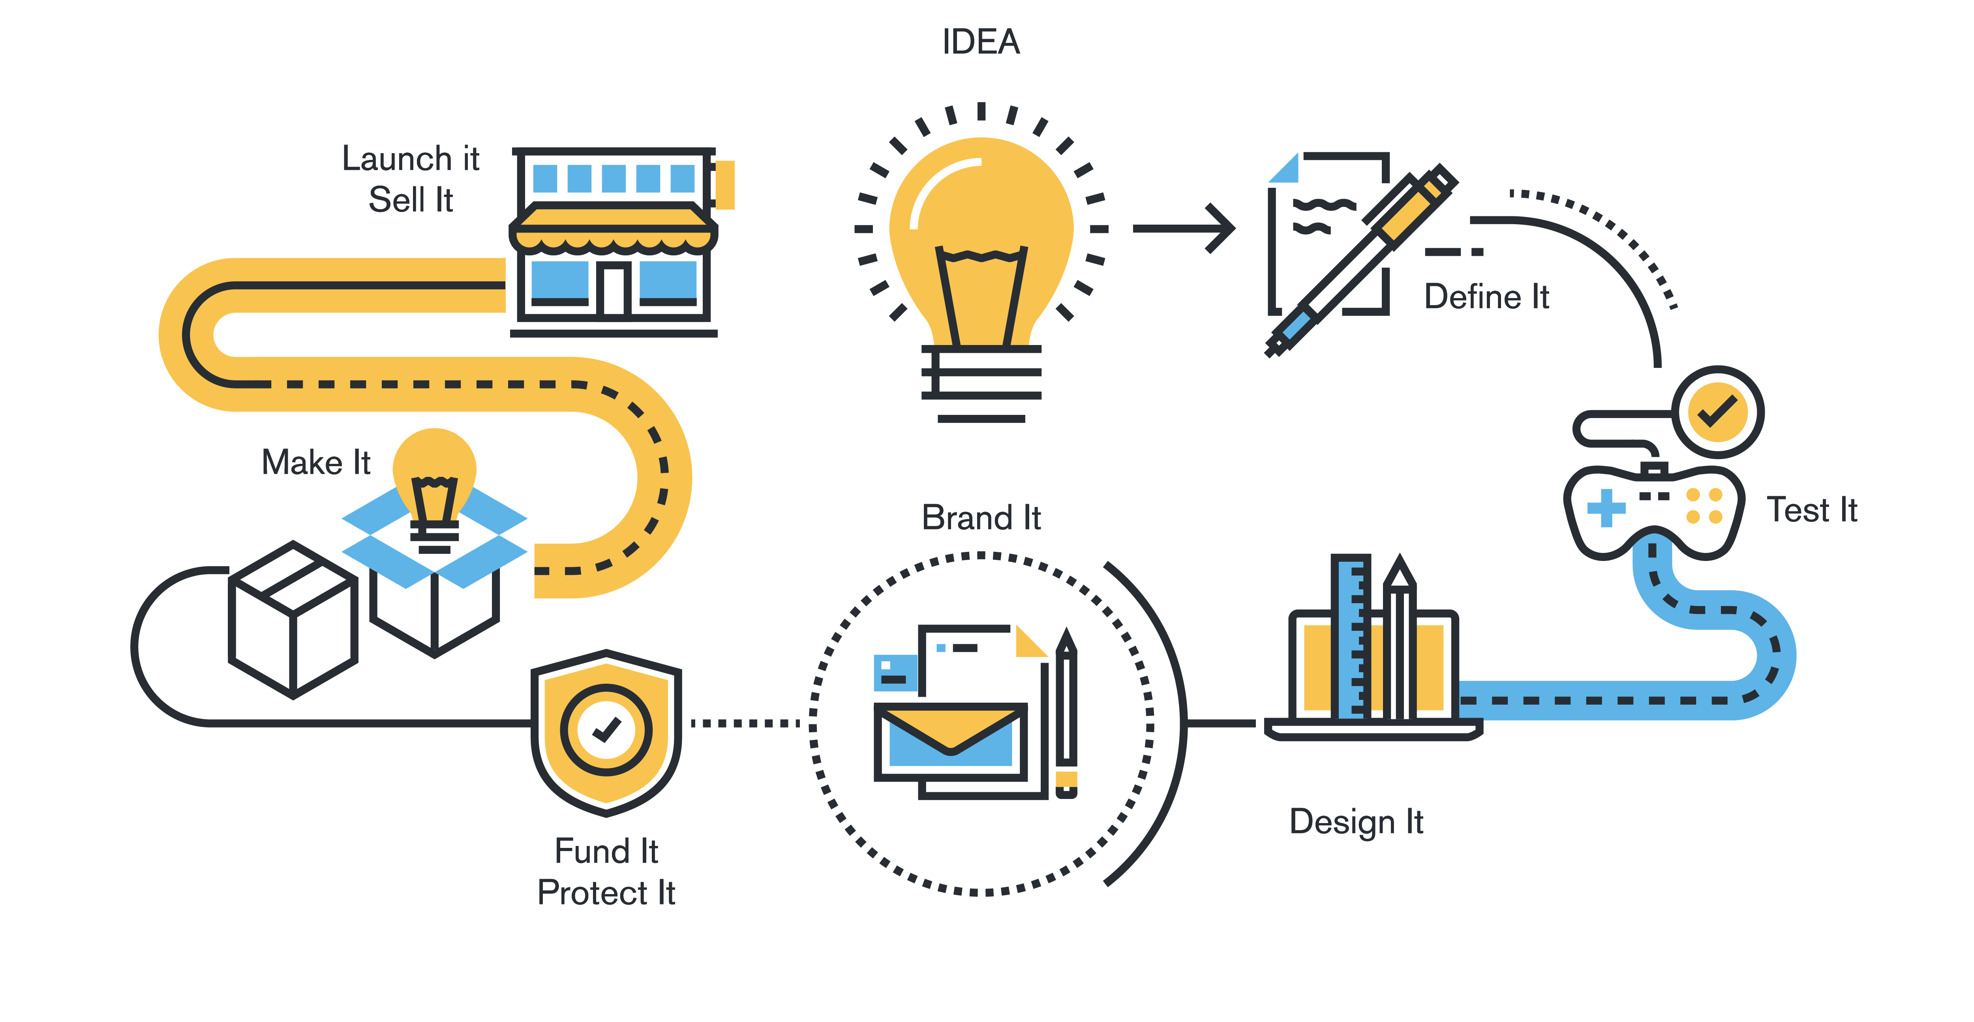
On time
On price
…and 100% fit!
The scope and capability of the WikiSuite digital information management system is mind-boggling. Bluntly, it offers a level of dexterity and capability that isn’t available in commercial software.
And did we mention it’s FREE?
When we’re delivering your 100% best-fit solution we don’t have to worry about writing code. That means we can focus on tailoring your digital platform to deliver the functionality your business needs.

Slide 21
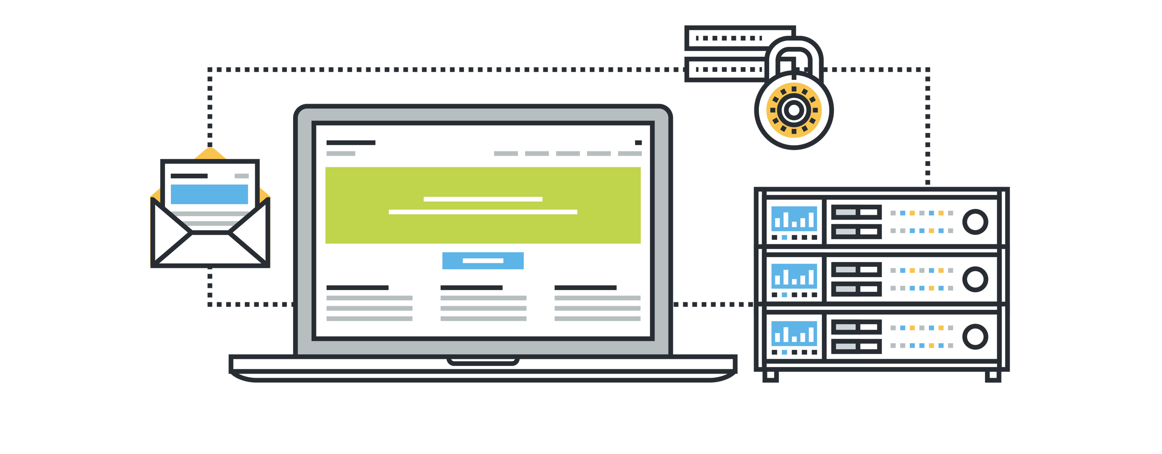
Your Data Safety is Always Our First Concern
We often hear concerns that open source software isn’t safe; or at least it isn’t as safe as commercial software
That’s EVEN THOUGH we adopt precisely the same controls and tools to validate the cleanliness of our code
Download our data security paper to dig into the detail of our comprehensive approach to keeping your data safe

Slide 22

No Legacy Burden
Legacy burden describes the technology support overheads and upgrade costs associated with keeping aging IT systems alive.
When companies increase the numeracy of apps and rely on proprietary software that depends on a small talent pool, they seismically increase risks of costly legacy burden.
WikiSuite is owned by its community, not a single commercial organization.
And it has a global community of more than 20,000 practitioners, which means you’ll never be short of someone to call on to support and adapt it.

Slide 23
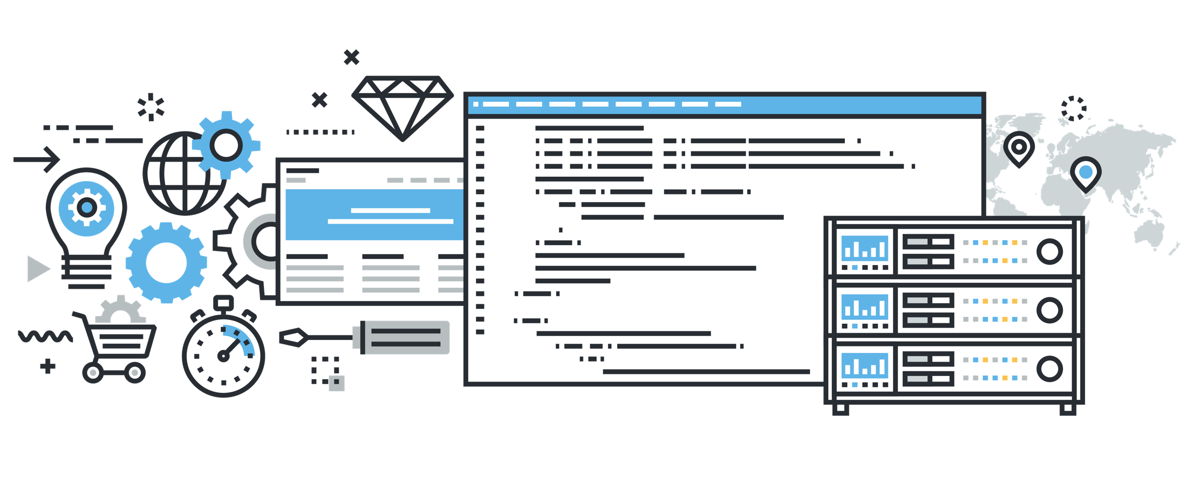
Always a Competitive Advantage
EvoluData designs your technology ecosystem to deliver 100% of your digital transformation.
That means you get a best-fit turnkey solution that ensures your enterprise can work smarter and more efficiently than your competitors.
In a digital world characterized by hypercompetitive markets that are constantly being re-invented by technology, the competitive advantage we bring might make a difference, don’t you think?
Competitive advantage comes from delivering more value to your customers at lower cost
Most commercial software simply replicates a process automation to an entire peer group of businesses
That’s because software isn’t tailored to fit your precise business model orchestration

Slide 24

Great People!
You may know this already, but we’ve got some of the greatest people in our team, friendly too
Don’t be surprised if you’re surprised by the dedication and commitment in our people to deliver you the best result. It’s encoded in our DNA!

Slide 25
Take the next step to discovering open source

